Slide 1
Architectural blockers for autoscaling in OpenSearch
Amitai Stern

Slide 2
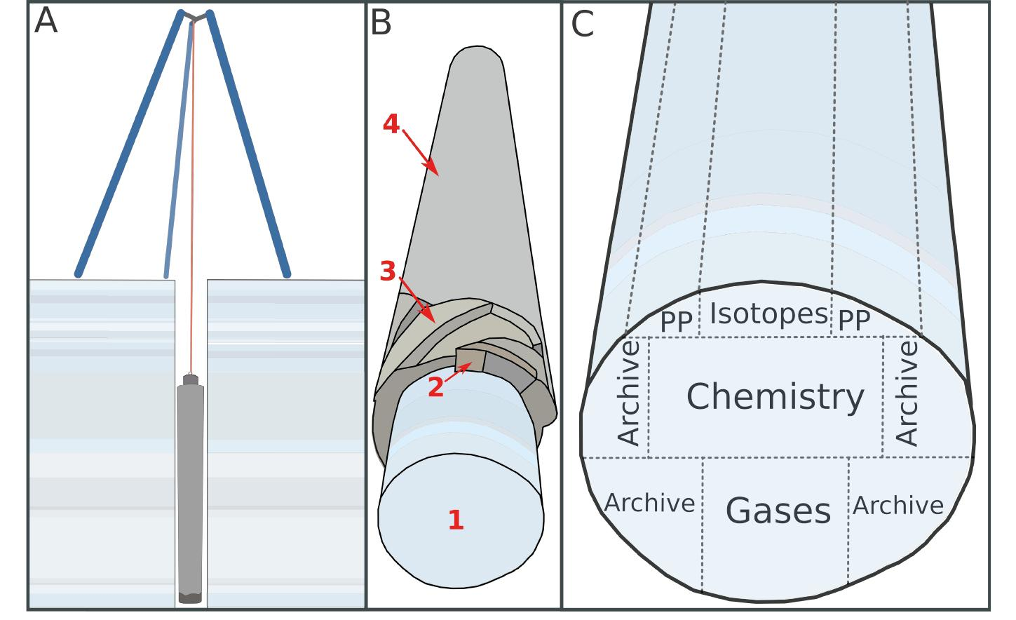

Indexing objects
Ice-core samples
Notes:
Object storage, I mean actual objects! Specifically in this first case - ice-cores. Ice cores are cylinders of ice that are drilled from glaciers or ice sheets and provide a record of the Earth's past climate and environment.

Slide 3


Indexing objects
Cultural and historical objects

Slide 4


Indexing objects
Cultural and historical objects

Slide 5
Notes:
(Tie the analogy to OpenSearch) OpenSearch provides ways to scale horizontally.
Knowing how to scale a cluster is more than just adding and removing nodes.

Slide 6

Amitai Stern
Team Lead @ Logz.io, OpenSearch TSC member
Notes:
My name is Amitai Stern, I live in Sunnyvale, California, I’m a member of the OpenSearch Technical Steering Committee, I’m the team lead of telemetry storage at Logz.io, in charge of the several dozen OpenSearch clusters across many regions, with petabytes of customers’ logging and tracing data, in addition to customers’ monitoring data on Thanos and on M3db clusters. A benefit I wish for you to have gained from this talk is clarity around scaling OpenSearch so you can plan for it actively rather than be unpleasantly surprised. Perhaps a better intuition for what it would take to implement auto-scaling.

Slide 7
Horizontal Scaling
Essential skill for managing OpenSearch clusters
Notes:
Over time, things change in a database:
The query throughput increases, so you want to add more CPUs to handle the load.
The dataset size increases, so you want to add more disks and RAM to store it.
A machine fails, and other machines need to take over the failed machine’s responsibilities.
What do we expect to be the result of scaling out?
1 node can handle x load -> 10 nodes can handle 10x load
If the load is not spread out evenly that condition is not met
So we need to make sure that when we scale-out and scale-in the load is still spread out as evenly as possible
Hot spot - when one node has disproportionately high load

Slide 8
Horizontal Scaling
_id: a$i_sdns8
hash(a$i_sdns8) -> …1345
…1345 Mod 4 = 1
Shard 0
Shard 1
Shard 2
Shard 3
PUT
Notes:
—----------- How are documents distributed among the opensearch shards?
How not to do it: hash mod N The problem with the mod N approach is that if the number of nodes N changes, most of the keys will need to be moved from one node to another.
Fixed number of partitions - Fortunately, there is a fairly simple solution: create many more partitions than there are nodes, and assign several partitions to each node

Slide 9
Horizontal Scaling
_id: a$i_sdns8
Shard 0
Shard 1
Shard 2
Shard 3
Shard 4
GET
_id: a$i_sdns8
Notes:
—----------- How is are documents distributed among the opensearch shards?
How not to do it: hash mod N The problem with the mod N approach is that if the number of nodes N changes, most of the keys will need to be moved from one node to another.
Fixed number of partitions - Fortunately, there is a fairly simple solution: create many more partitions than there are nodes, and assign several partitions to each node

Slide 10
Horizontal Scaling
_id: a$i_sdns8
hash(a$i_sdns8) -> …1345
…1345 Mod 5 = 0
Shard 0
Shard 1
Shard 2
Shard 3
Shard 4
GET
?
_id: a$i_sdns8
Notes:
—----------- How is are documents distributed among the opensearch shards?
How not to do it: hash mod N The problem with the mod N approach is that if the number of nodes N changes, most of the keys will need to be moved from one node to another.
Fixed number of partitions - Fortunately, there is a fairly simple solution: create many more partitions than there are nodes, and assign several partitions to each node

Slide 11
Horizontal Scaling
_id: a$i_sdns8
hash(a$i_sdns8) -> …1345
…1345 Mod 4 = 0
Shard 0
Shard 1
Shard 2
Shard 3
Shard 4
GET
_id: a$i_sdns8
Fixed number of shards!
Notes:
—----------- How is are documents distributed among the opensearch shards?
How not to do it: hash mod N The problem with the mod N approach is that if the number of nodes N changes, most of the keys will need to be moved from one node to another.
Fixed number of partitions - Fortunately, there is a fairly simple solution: create many more partitions than there are nodes, and assign several partitions to each node

Slide 12

Horizontally Scaling OpenSearch
When is it simple?

Slide 13
Horizontally Scaling OpenSearch
When is it simple?

Slide 14
Horizontally Scaling OpenSearch
When is it simple?

Slide 15
Horizontally Scaling OpenSearch
When is it simple?

Slide 16
Horizontally Scaling OpenSearch
When is it simple?

Slide 17

Horizontally Scaling OpenSearch
When is it complicated?

Slide 18
Horizontally Scaling OpenSearch
When is it complicated?
Index1
Index1
Index1
Index1
SHARD
SHARD
SHARD
SHARD

Slide 19
Horizontally Scaling OpenSearch
When is it complicated?
Index1
Index1
Index1
Index1
SHARD
SHARD
SHARD
SHARD
Index2
Index2
Index2
Index2
Index2
SHARD
SHARD
SHARD
SHARD
SHARD

Slide 20
Horizontally Scaling OpenSearch
When is it complicated?
Index1
Index1
Index1
Index1
SHARD
SHARD
SHARD
SHARD
Index2
Index2
Index2
Index2
Index2
SHARD
SHARD
SHARD
SHARD
SHARD

Slide 21
Horizontally Scaling OpenSearch
When is it complicated?
Index1
Index1
Index1
Index1
SHARD
SHARD
SHARD
SHARD
Index2
Index2
Index2
Index2
SHARD
SHARD
SHARD
SHARD
Index2
SHARD

Slide 22
Horizontally Scaling OpenSearch
When is it complicated?
Index1
Index1
Index1
Index1
SHARD
SHARD
SHARD
SHARD
Index2
Index2
Index2
Index2
SHARD
SHARD
SHARD
SHARD
Index2
SHARD
Index3
Index3
Index3
Index3
SHARD
SHARD
SHARD
SHARD

Slide 23


Cluster Topologies for Scaling
“That's my secret, Cap. I'm always angry." - Bruce Banner

Slide 24
Cluster Topologies for Scaling
Maintain “burst indices”
Data stream
Write alias

Slide 25
Cluster Topologies for Scaling
Maintain “burst indices”
Data stream
Write alias

Slide 26
Cluster Topologies for Scaling
Maintain “burst indices”
box_type: low
box_type: burst
Write alias
Write alias
Write alias
Write alias
<<< LOW THROUGHPUT

Slide 27
Cluster Topologies for Scaling
Maintain “burst indices”
box_type: low
box_type: burst
Write alias
Write alias
Write alias
Write alias
<<< (NOT SO) LOW THROUGHPUT

Slide 28
Cluster Topologies for Scaling
Maintain “burst indices”
box_type: low
box_type: burst
Write alias
Write alias
Write alias
Write alias
Write alias
Write alias
<<< HIGH THROUGHPUT

Slide 29
Cluster Topologies for Scaling
Maintain “burst indices”
box_type: low
box_type: burst
Write alias
Write alias
Write alias
Write alias
<<< (NOT SO) LOW THROUGHPUT

Slide 30
Cluster Topologies for Scaling
Maintain “burst indices”
box_type: low
box_type: burst
Write alias
Write alias
Write alias
Write alias
<<< LOW THROUGHPUT

Slide 31
Cluster Topologies for Scaling
Maintain a “burst cluster”
Data stream
Burst Cluster
Cluster 1

Slide 32
Cluster Topologies for Scaling
Maintain a “burst cluster”
Data stream
Burst Cluster
Cluster 1

Slide 33
Cluster Topologies for Scaling
Maintain a “burst cluster”
10
5
60
10

Slide 34
Cluster Topologies for Scaling
Maintain a “burst cluster”
10
5
60
10

Slide 35
Cluster Topologies for Scaling
Maintain a “burst cluster”
Cross Cluster Search
10
5
60
10

Slide 36
Cluster Topologies for Scaling
Maintain a “burst cluster”
10
5
60
10

Slide 37
Cluster Topologies for Scaling
Maintain a “burst cluster”
S3

Slide 38
Cluster Topologies for Scaling
Maintain a “burst cluster”
S3

Slide 39
Summary

Slide 40


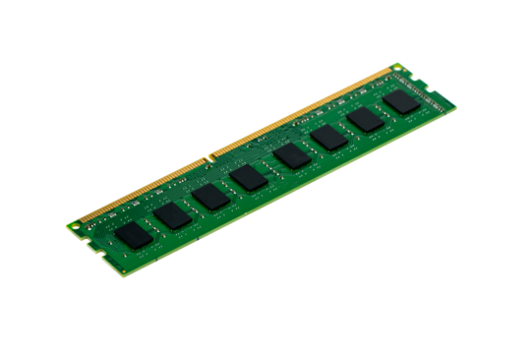
Summary
Which resource do we want to scale? Some changes are a one way door!
LOAD

Slide 41
Summary
We can work around the limitations by planning for future scale
10
box_type: low
box_type: burst
5
Write alias
Write alias
Write alias
Write alias
Write alias
Write alias
60
10
<<< HIGH THROUGHPUT

Slide 42

Should we develop autoscaling?
Notes:
Users often ask why Elasticsearch doesn’t support shard-splitting—the ability to split each shard into two or more pieces. The reason is that shard-splitting is a bad idea:
Splitting a shard is almost equivalent to reindexing your data. It’s a much heavier process than just copying a shard from one node to another.
Splitting is exponential. You start with one shard, then split into two, and then four, eight, sixteen, and so on. Splitting doesn’t allow you to increase capacity by just 50%.
Shard splitting requires you to have enough capacity to hold a second copy of your index. Usually, by the time you realize that you need to scale out, you don’t have enough free space left to perform the split.
In a way, Elasticsearch does support shard splitting. You can always reindex your data to a new index with the appropriate number of shards (see Reindexing Your Data). It is still a more intensive process than moving shards around, and still requires enough free space to complete, but at least you can control the number of shards in the new index.

Slide 43

Should we develop autoscaling?
Notes:
Users often ask why Elasticsearch doesn’t support shard-splitting—the ability to split each shard into two or more pieces. The reason is that shard-splitting is a bad idea:
Splitting a shard is almost equivalent to reindexing your data. It’s a much heavier process than just copying a shard from one node to another.
Splitting is exponential. You start with one shard, then split into two, and then four, eight, sixteen, and so on. Splitting doesn’t allow you to increase capacity by just 50%.
Shard splitting requires you to have enough capacity to hold a second copy of your index. Usually, by the time you realize that you need to scale out, you don’t have enough free space left to perform the split.
In a way, Elasticsearch does support shard splitting. You can always reindex your data to a new index with the appropriate number of shards (see Reindexing Your Data). It is still a more intensive process than moving shards around, and still requires enough free space to complete, but at least you can control the number of shards in the new index.

Slide 44




Q&A
@amitaistern
amitai-stern

